Slide 1
Paragraph
Topic > Supporting sentences
Unity
The paragraph is a group of sentences that fleshes out a single idea. For it to be effective, it must have a topic sentence, sentences that support the main idea, and a consistent flow.
Each paragraph is focused solely on a single idea, point, or argument that is being discussed.
With this said, all sentences in the paragraph are all telling the reader one topic.

Slide 2
Paragraph
Topic > Supporting sentences
Unity
Manny Pacquiao is a terrific Filipino boxer. He has a good family. He has fought against several world famous boxers from different countries so strongly that he becomes the best loved boxer in the world today. He is married, and he is a good provider to his family. He devotes much of his time preparing for his fights and defending his boxing title from different contenders. He loves to travel, and from his journeys, he gained much experience in life.
The paragraph is a group of sentences that fleshes out a single idea. For it to be effective, it must have a topic sentence, sentences that support the main idea, and a consistent flow.

Slide 3
Paragraph
Topic > Supporting sentences
Coherence
Commonly referred to as the flow of your writing.
This can be achieved by arranging the sentences to show a clear sequence of ideas and using structural or transitional devices to show the logical connections between sentences.
The paragraph is a group of sentences that fleshes out a single idea. For it to be effective, it must have a topic sentence, sentences that support the main idea, and a consistent flow.

Slide 4
Paragraph
Coherence
Topic > Supporting sentences
for example, for instance, namely, specifically
accordingly, consequently, hence, therefore
additionally, again, also, besides, in addition
first, second, third… next, then, finally
finally, in a word, in brief, in conclusion
but, however, on the other hand, nonetheless
The paragraph is a group of sentences that fleshes out a single idea. For it to be effective, it must have a topic sentence, sentences that support the main idea, and a consistent flow.

Slide 5
Methods of paragraph development
a. Definition
When writing a definition paragraph, we take a thing or an idea and explain what it is. In this type of paragraph development, the topic sentence identifies a term and suggests the overall context in which it is used.
Example:
Family therapy is a method of helping troubled families work out their problems and conflicts. Therapy involves discussion sessions directed by a trained therapist. All members of the family are encouraged to come to the sessions. The goal of each session is to work out possible solutions to a particular problem.
Development means to delve deeper into an idea. In writing an effective paragraph, there are certain methods that we can employ in order to present our ideas in a better way.

Slide 6
Methods of paragraph development
b. Sequence
In a sequence paragraph, we are writing to describe a series of events or a process in sort of order. Usually, this order is based on time. In this pattern, the details are presented in the order in which they happened.
Example:
He was recently elected as a senator. Previously, he worked as a lawyer in Makati City. He won the party leadership last year. Afterwards, he won the election. When he won the party leadership, he was still working as a lawyer. After winning a seat in the House of Representatives, he made sure he had a majority of seats.
Development means to delve deeper into an idea. In writing an effective paragraph, there are certain methods that we can employ in order to present our ideas in a better way.

Slide 7
Methods of paragraph development
c. Comparison and Contrast
The comparison-contrast pattern is used when similarities and differences of two or more actions, ideas, or events are being discussed. A paragraph may discuss only similarities, only differences, or both similarity and difference.
Example:
Divina thought over whether to buy a sling bag or a back pack. The sling bag costs only P150.00, compared to the P250.00 price tag on the back pack. However, the back pack is more useful than the sling bag. On the other hand, the sling bag could carry her things. Divina preferred to put all her books and notebooks in a back pack.
Development means to delve deeper into an idea. In writing an effective paragraph, there are certain methods that we can employ in order to present our ideas in a better way.

Slide 8
Methods of paragraph development
d. Cause and Effect
Cause and effect shows the relationship between two things when one thing makes the other thing happen. Usually, the expressions “if…then” are used in this type of paragraphs. The cause and effect development is also called an explanation paragraph because it explains how or why something happens.
Example:
Filipinos move continuously to the United States because they want to have better living conditions there. The large influx of people in the U.S. was due to economic pressures in the Philippines. Living conditions were terrible. Consequently, many Filipinos move to the United States.
Development means to delve deeper into an idea. In writing an effective paragraph, there are certain methods that we can employ in order to present our ideas in a better way.

Slide 9
Methods of paragraph development
e. Process
A process is a series of steps that lead to a desired result. It explains how to do, create, or understand something. In writing such, we must know the procedures down to the smallest detail. In summary, a process paragraph gives direction by telling someone how to do something or gives information about how some process was or is to be completed.
Example:
Buying a good car is easy if you know these steps. First, you must decide on a new or used one. You must also figure out your budget and how much you want to spend. Then, if you decide to buy a used car, check the values from the newspaper. For example, you can research new cars in consumer magazines and the Internet for price, safety, and value. These steps can help you select the right car for many years of reliable transportation.
Development means to delve deeper into an idea. In writing an effective paragraph, there are certain methods that we can employ in order to present our ideas in a better way.

Slide 10
Methods of paragraph development
f. Analogy
An analogy is an expression of similarity between two unlike things. This type of paragraph development is used to explain something unknown in terms of something known. A good analogy can help readers understand a complicated subject or view a common experience in a new way.
Example:
Pupils are more like oysters than sausages. The job of teaching is not to stuff them and then seal them up, but to help them open and reveal the riches within. There are pearls in each of us, if only we knew how to cultivate them with ardor and persistence.
(Sydney J. Harris, "What True Education Should Do," 1964)
Development means to delve deeper into an idea. In writing an effective paragraph, there are certain methods that we can employ in order to present our ideas in a better way.

Slide 11

The essay
2
+
An essay is a nonfiction work that deals with one subject, often in a personal way. It is a longer composition written to communicate a main point to a particular audience for a specific purpose. It is also known for being a structured piece of writing with a series of well-connected paragraphs.

Slide 12
The essay
2
+
A paragraph is a group of sentences that fleshes out a single idea. In order for a paragraph to be effective, it must begin with a topic sentence, have sentences that support the main idea, and maintain a consistent flow.

Slide 13
Parts of an essay
Thesis Statement: This is the controlling mechanism or the focused topic that states the purpose, method of discussion, and the point of discussion.
Supporting Paragraphs: This is also known as the body of the essay. It is composed of supporting paragraphs that explain the thesis statement.
Conclusion: This the last paragraph in the essay designed to bring the discussion to a satisfying close. It can be a restatement of the thesis statement, a thoughtful remark about the topic, or simply a summary of the supporting paragraphs in the body.

Slide 14
Drafting an essay
TOPIC SENTENCE
-it contains the main idea of the paragraph
should be specific and tell the reader
exactly what the paragraph will be about.
THESIS STATEMENT
- is the controlling mechanism that will state the purpose, method of discussion ,and the point of discussion.
- is the focused topic.

Slide 15
Drafting an essay
Paragraph
Topic Sentence
Supporting Sentence 1
Supporting Sentence 2
Supporting Sentence 3
Concluding Sentence
Essay
Introduction Paragraph with Thesis Statement
Body
Supporting Paragraph 1
Topic Sentence 1
Development Sentences
Supporting Paragraph 2
Topic Sentence 2
Development Sentences
Conclusion Paragraph

Slide 16
Example
Thesis statement: There are several negative effects of credit cards.
(What is the focused topic?)
I. One has more money to spend.
II. One has more opportunity to go into debt.
III. The worst effect is the potential for identity theft.

Slide 17
Types of essay
An essay is one effective way of expressing and sharing our ideas. As such, essays can be written in specific ways depending on the purpose of the writer. Here are the general types of essay:
Descriptive Essay: Painting a picture
Narrative Essay: Telling a Story
Expository Essay: Presenting the facts
Persuasive Essay: Convincing the reader

Slide 18
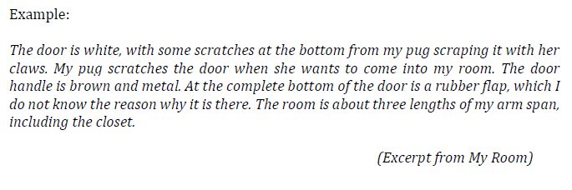
Types of essay
Descriptive Essay: Painting a picture
we use words to paint pictures
we describe a person, place, object, event, or idea
details often come from our own senses—smell, taste, touch, hearing, and sight
we are presenting a clear and vivid picture in our reader’s minds

Slide 19
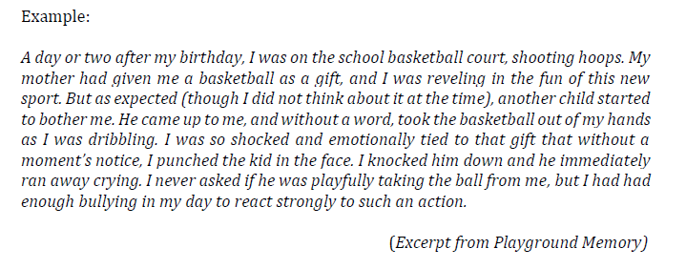
Types of essay
Narrative Essay: Telling a Story
means to recite the details
unfolding of a series of events
gives details of an experience or event in the order in which they happened

Slide 20
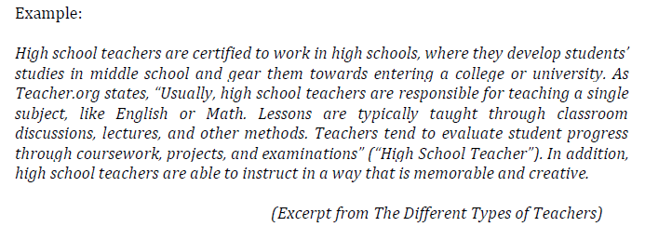
Types of essay
Expository Essay: Presenting the facts
means to inform, clarify, or explain
informative in nature
answers the questions how and why
we explain or define a topic using facts, statistics and examples
Writers need to remember that what matters most in this type of essay is the information presented, not personal feelings

Slide 21
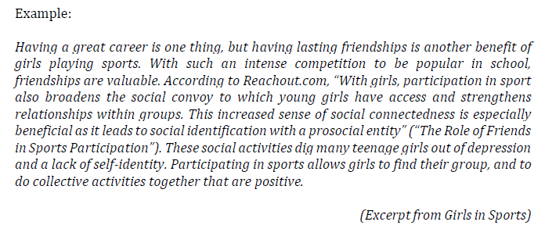
Types of essay
Persuasive Essay: Convincing the reader
it also presents facts but its goal is to convince the readers to accept the writer’s point of view or recommendation
writer also presents facts, sound reasoning, and logic in building the case

Slide 22
The writing process
2
+
In writing, we need to write for the ‘educated idiot’—meaning, the reader knows nothing about the topic but does understand grammar and structure.
Although writers follow their own processes, writing involves at least four distinct steps.
1. Prewriting
Prewriting is anything that is done before even writing the draft of the document. It includes thinking, taking notes, talking to others, brainstorming, outlining, and gathering information. Although the first step that we engage in, generating ideas is an activity that occurs throughout the writing process.

Slide 23
The writing process
2
+
In writing, we need to write for the ‘educated idiot’—meaning, the reader knows nothing about the topic but does understand grammar and structure.
Although writers follow their own processes, writing involves at least four distinct steps.
1. Prewriting
Prewriting includes:
Finding Your Idea: Ideas are all around us. We can draw inspiration from a routine, an everyday situation, or a childhood memory among others.
Building on Your Idea: There are some ways on how we can build and expand on our ideas. The most common methods are free writing and brainstorming.
Planning and Structuring: This is the step wherein we piece the puzzle together. It is the time for us to sort through our ideas and choose the ones we can use.

Slide 24
The writing process
2
+
In writing, we need to write for the ‘educated idiot’—meaning, the reader knows nothing about the topic but does understand grammar and structure.
Although writers follow their own processes, writing involves at least four distinct steps.
2. Drafting
Drafting occurs when we put our ideas into sentences and paragraphs. It is in this stage where we concentrate on explaining and supporting our ideas fully. We also begin to connect these ideas with each other. At this stage, we don’t usually pay attention to the rules of grammar.

Slide 25
The writing process
2
+
In writing, we need to write for the ‘educated idiot’—meaning, the reader knows nothing about the topic but does understand grammar and structure.
Although writers follow their own processes, writing involves at least four distinct steps.
3. revising
Revision is the key to effective documents. In this stage, we think more deeply about our readers’ needs and expectations. It is also in this stage wherein we refine our prose, making each sentence as concise and accurate as possible.

Slide 26
The writing process
2
+
In writing, we need to write for the ‘educated idiot’—meaning, the reader knows nothing about the topic but does understand grammar and structure.
Although writers follow their own processes, writing involves at least four distinct steps.
3. revising
We may follow these steps:
Add: Give your readers all the information they need.
Rearrange: Consider the flow, pacing, and sequencing of the manuscript.
Remove: Eliminate information that doesn’t quite fit in the composition.
Replace: If something is not working, replace it.

Slide 27
The writing process
2
+
In writing, we need to write for the ‘educated idiot’—meaning, the reader knows nothing about the topic but does understand grammar and structure.
Although writers follow their own processes, writing involves at least four distinct steps.
4. Editing
This is the stage to fine tune the document line by line. Check for repetition, clarity, grammar, spelling, and punctuation. Change words that are not used correctly. Make sure your using the correct format for the composition.

Slide 28
You do note!
Avoid the following in your conclusion:
1.Announcing your conclusion
I want to end with this thought........
2.Complaining or apologizing about the assignment
Although this is not my favorite subject to discuss, I told you how I feel about it.
3. Presenting an afterthought or new idea
(Do not add something you forgot to discuss in the body of the paper)

Slide 29

THANK YOU! ☺
2
+
2
+

Slide 30
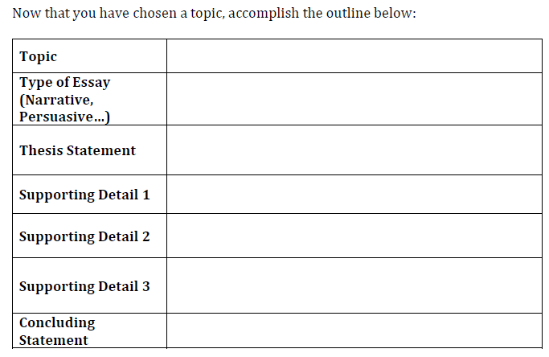
GROUP ACTIVITY
Essay Writing:
Write about a topic that you like. You may choose from the writing prompts that your instructor will provide to your class.
I.

Slide 31
Group activity
Essay Writing:
II. Complete your essay (as a group). Word document: TNR 12, 1.5 spacing. Group # and members.
Essay must have the following:
Thesis Statement
Body (three paragraphs)
Conclusion

Slide 32
ASSIGNMENT
Essay Writing:
III. Present the outline of your chosen essay using Power point presentation.
Presentation and Submission:

